Slide 1
Cafe Rewards Offers Dashboard
Insights on Engagement, Segmentation, and Offer Performance
Presented by: Asoegwu Chinonso
Date: July 2025

Slide 2
Executive Summary
The dashboard analyzes how customers respond to various cafe reward offers.
It explores customer demographics, offer performance, and transaction trends.
Key engagement metric: 75% Click-Through Rate (CTR)
Objective: Identify which offers and segments drive conversions.

Slide 3
Key Metrics Overview
Reach
14.8K
Impressions
66.5K
Views
49.9K
CTR
75.0%
Offer-Linked Purchases
38.0K
(27.3% of total purchases)

Slide 4
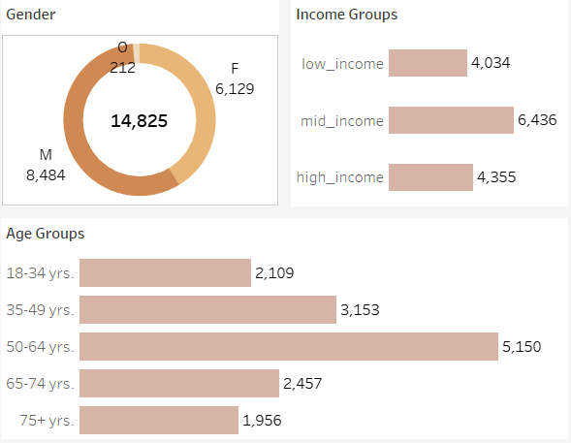
Demographic Engagement Breakdown
Gender: 57% Male (8,484), 41% Female
Income: Most engaged = Mid-income
Age Group: 50–64 yrs are most active

Slide 5
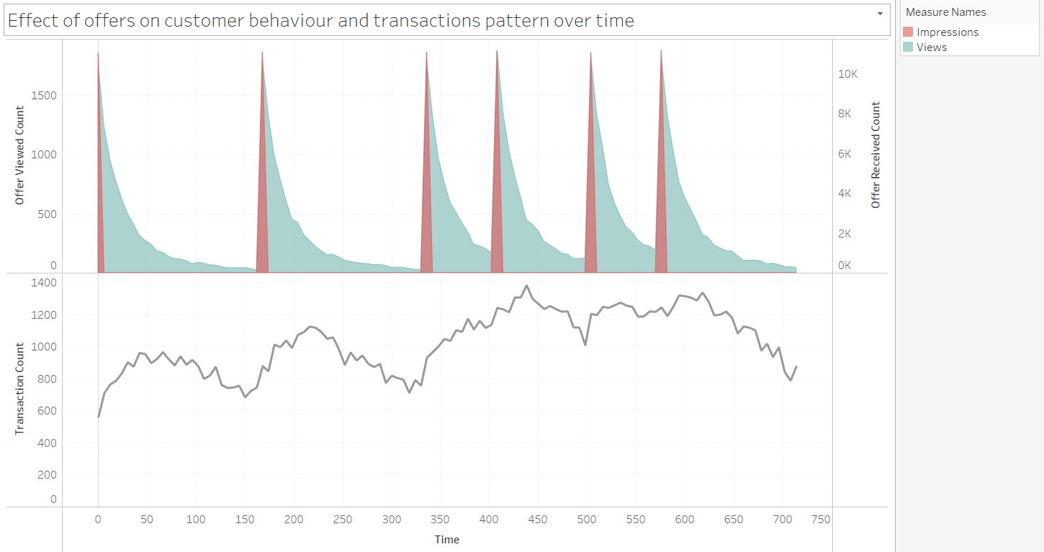
Engagement Trend Over Time
Offers Viewed vs. Transactions Over Time
Peaks align with campaign launches
Followed by rise in transactions

Slide 6
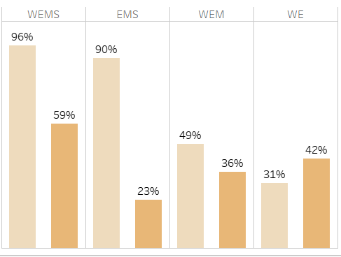

Channel Performance
Channels: WEMS, EMS, WEM, WE
Highest CTR: WEMS (96%)
EMS and WEMS outperform others in both CTR and Offer Completion

Slide 7
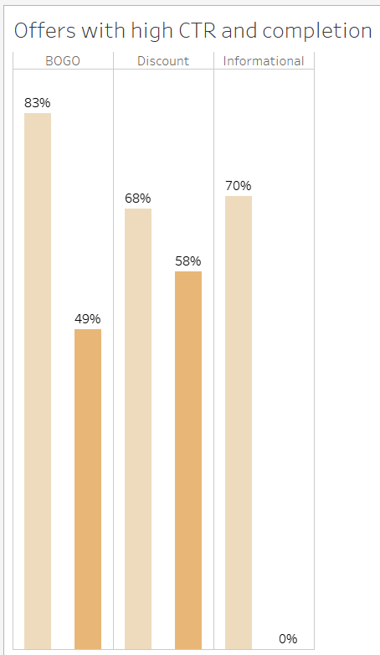
Offer Type Performance
BOGO offers: CTR > 83% consistently
Discounts: Highest completion rate, implying that customers preferred discounted prices to a "buy one get one free" offer.
Informational: High CTR (70.%) but 0% completion, suggests strong interest but lack of conversion

Slide 8
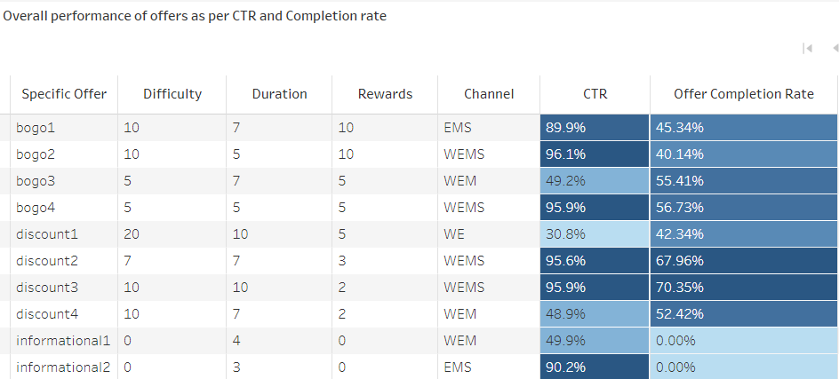
Top Performing Offers
bogo2, bogo4, discount2, discout3: CTR > 95%
discount3: Best completion rate, this could be as a result of moderate difficulty and longer duration.
bogo3: Best balance of difficulty, reward, and CTR
High-performing offers concentrated in EMS/WEMS channels

Slide 9
Recommendations
Focus on BOGO offers via WEMS/EMS
Improve follow-through messaging on Informational offers
Target Mid-income, Female, 35–44 years for higher conversion.
Offers can be sent as frequently as twice a week, with the same success rate and customer engagement.
Launch offers suitable for the affordability of low-income customers.

Slide 10
Next Steps
Conduct A/B tests for underperforming discount offers
Refine segmentation with behavior analytics
Monitor offer performance monthly and adjust campaigns

Slide 11
Thank You
Contact: asorchinonso@gmail.com
Portfolio: datascienceportfol.io/Iamphenomenal
Github: lamphenomenal.github.io

